Slide 1

By: Zeeshan Ali (286 G) Muhammad Zain (294G) Muhammad Ammar Jan (435 G)

Slide 2

Topic : Car Parking Tax collection

Slide 3
Abstract
The aim of this paper is to automate the car and the car parking as well. It discusses a project which presents a miniature model of an automated car parking system that can regulate and manage the number of cars that can be parked in a given space at any given time based on the availability of parking spot.

Slide 4
Objective
To reduce dependence on the car, particularly in town centres. ... To reduce, where possible, environmental damage caused by cars and car ownership, particularly in residential areas. To reduce, where possible, competition for road space, between residents and other groups.

Slide 5
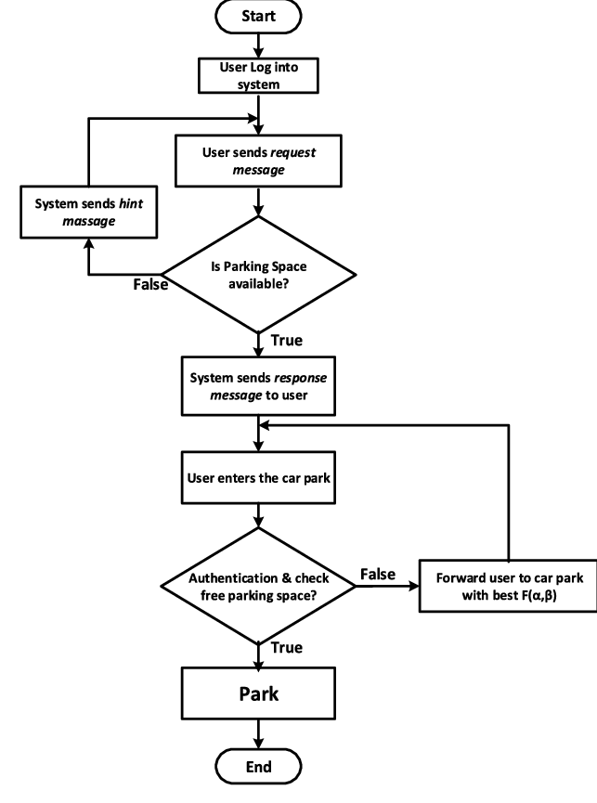
Method

Slide 6
What is First Come First Serve Method?
First Come First Serve (FCFS) is an operating system scheduling algorithm that automatically executes queued requests and processes in order of their arrival. It is the easiest and simplest CPU scheduling algorithm. In this type of algorithm, processes which requests the CPU first get the CPU allocation first. This is managed with a FIFO queue. The full form of FCFS is First Come First Serve.

Slide 7
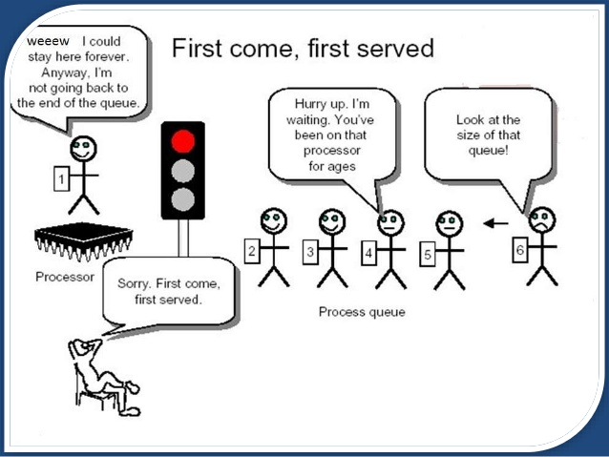

Slide 8
Characteristics of FCFS method
It supports non-preemptive and pre-emptive scheduling algorithm.
Jobs are always executed on a first-come, first-serve basis.
It is easy to implement and use.
This method is poor in performance, and the general wait time is quite high.

Slide 9
Advantages of FCFS
Here, are pros/benefits of using FCFS scheduling algorithm:
The simplest form of a CPU scheduling algorithm
Easy to program
First come first served

Slide 10
Disadvantages of FCFS
Here, are cons/ drawbacks of using FCFS scheduling algorithm:
It is a Non-Preemptive CPU scheduling algorithm, so after the process has been allocated to the CPU, it will never release the CPU until it finishes executing.
The Average Waiting Time is high.
Short processes that are at the back of the queue have to wait for the long process at the front to finish.
Not an ideal technique for time-sharing systems.
Because of its simplicity, FCFS is not very efficient.
Summary

Slide 11
Summary of FCFS
Definition: FCFS is an operating system scheduling algorithm that automatically executes queued requests and processes by order of their arrival
It supports non-preemptive and pre-emptive scheduling
algorithm.
FCFS stands for First Come First Serve
A real-life example of the FCFS method is buying a movie ticket on the ticket counter.
It is the simplest form of a CPU scheduling algorithm
It is a Non-Preemptive CPU scheduling algorithm, so after the process has been allocated to the CPU, it will never release the CPU until it finishes executing.
Summary

Slide 12
Results
Further modifications result in even better systems, such as reserving the parking space online and using a smart card with it will help the driver find the free space.
The services which the Intelligent Parking System should provide in the future are
The parking availability information system and parking reservation system should provide advanced navigation services.
The mobile electric commerce system and a continuously working gate system should collect the toll charges electrically.
An automated navigation system should assist in safe driving.
An in-facility navigation system should provide the best possible traffic management.
Provision of effective security for the safety of cars.
Provision of strong functions for facilitating administrators and managers in management of the parking facility.

Slide 13
Thanks

